Slide 1

Christopher B. Barrett
Cornell University
May 22, 2013 remarks at panel discussion on Risk & Vulnerability
Monash Centre for Development Economics
Resilience to Avoid and Escape Chronic Poverty:
Towards A Theoretical Foundation
for Development and Humanitarian Agencies

Slide 2
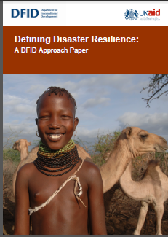
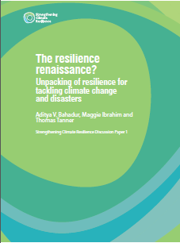
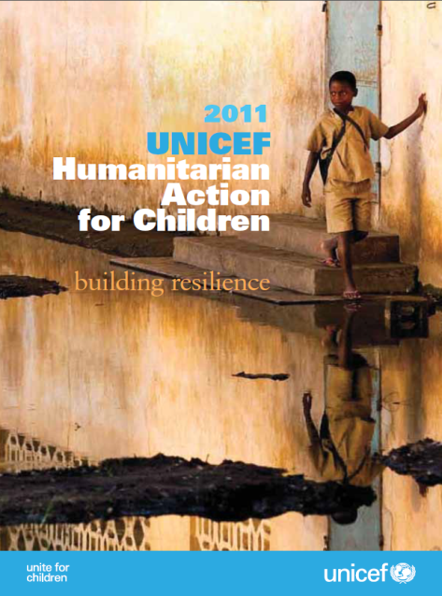
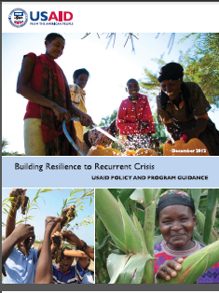
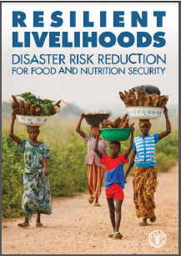
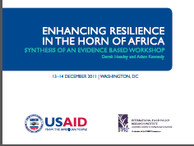
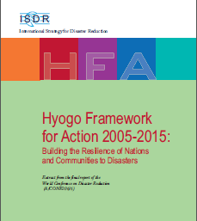
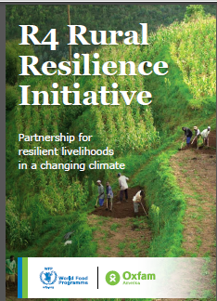

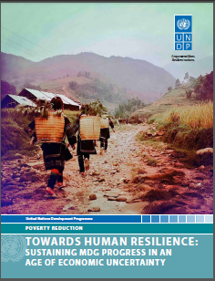
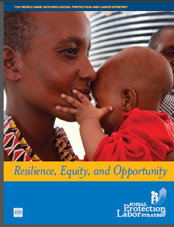
Motivation
“Resilience” has rapidly become a ubiquitous buzzword, but ill-defined concept within the development and humanitarian communities

Slide 3
Motivation
Lacking a theoretical foundation, agencies struggle to design and evaluate resilience programming.
Existing economic theories of welfare dynamics (especially ‘poverty traps’) closely parallel the ecological literature on resilience and resistance: similar ODE-based mathematics of dynamical systems.
So why not use these tools to advance a theory of resilience against chronic poverty and base measurement/evaluation on that theory?

Slide 4
Toward a Theory
Resilience of whom to what?
Subject of interest – quality of life, roughly Sen’s ‘capabilities’.
This implies a focus on individuals’ (and groups’) well-being within a system, not the state of a system itself. System has instrumental rather than intrinsic importance.
Focus further on minimizing the human experience of chronic poverty.
Do not focus on a specific source of risk b/c problem is uninsured exposure to a wide array of stressors (ex ante risk) and shocks (ex post, adverse realizations) to which resilience implies adaptability while staying/becoming non-poor.

Slide 5
Toward a Theory
Concept of Resilience for Development
Development resilience represents the likelihood over time of a person, household or other unit not being poor in the face of various stressors and in the wake of myriad shocks. If and only if that likelihood is high, then the unit is resilient.
Key Elements:
Standards of living: Focus on avoiding/escaping poverty
Effects of stressors: Uninsured risk influences dynamic incentives
Response to shocks: Temporary setbacks vs. permanent descents
Dynamical system vs. static representations of standards of living

Slide 6
Toward a Theory
Noncontroversially: NPZ >> CPZ >> HEZ
Those in CPZ or HEZ are chronically poor in expectation
The CEF reflects indiv/collective behaviors (agency/power) w/n system

Slide 7
Toward a Theory
The development ambition is to move people into the non-poor zone and keep them there.
The humanitarian ambition is to keep people from falling into HEZ … offers foundation of a rights-based approach to resilience.
For the current non-poor, seek resilience/resistance against shocks in the ecological sense: no shift to either of the lower, less desirable zones.
But for the current poor, those in HEZ/CPZ, the objective is productive disruption, to shift states to the NPZ.
Asymmetry is therefore a fundamental property of resilience against chronic poverty. Thus stability ≠ resilience.

Slide 8
Toward a Theory
Explicitly incorporate risk, move from CEF to CTD:
Note: The shape of the CTD affects the shape of the CEF
Transitory shocks (- or +) can have persistent effects
Risk may be endogenous to system state

Slide 9
Toward a Theory
Feedback between sub-systems can be crucial
If we represent the preceding conditional transitions as:
W_{t+1}=g(W_{t}|R_{t},ε_{t})
where W is welfare, R is the state of the natural resource, and ε is an exogenous stochastic driver
Then simply introducing feedback between R and W
(e.g., range conditions depend on herd size/stocking rate, disease reproduction depends on household incomes)
R_{t+1}=h(R_{t}|W_{t},ε_{t})
or allowing for drift in ε (e.g., due to climate change)
means the underlying CTD changes over time.
Then the resilience of the underlying resource base becomes instrumentally important to resilience against chronic poverty.

Slide 10
Toward a Theory
Coupled human and natural systems dynamics
Note: - Ecological resilience links to human resilience through reciprocal causality in coupled human/natural dynamics
- Many candidate relationships make prediction difficult at best

Slide 11
Programming implications
Objective: min likelihood people fall into HEZ/CPZ
Three options:
Shift people’s current state – i.e., move initial state rightward. Ex: asset transfers: cash, education, land.
Alter CTDs directly (and thereby ∆ system too). Ex: social protection - EGS, insurance, improved police protection, drought-resistant animal/plant genetics.
Change the underlying system structure – institutions/ technologies – induces ∆ in behaviors and CTDs. Prob: multi-scalar reinforcement – ‘fractal poverty traps’
Must explore the feedback within broader system to identify possible intervention points behind univariate dynamics.

Slide 12
Summary
Resilience is a popular buzzword now. But little precision in its use, either theoretically, methodologically or empirically.
Aim to help facilitate rigorous, precise use of the concept to help identify how best to avoid and escape chronic poverty.
This will require advances in theory, measurement and empirical work in many different contexts and over time.
Much to do in all areas … a massive research agenda, especially as agencies begin using resilience as a programming principle.

Slide 13
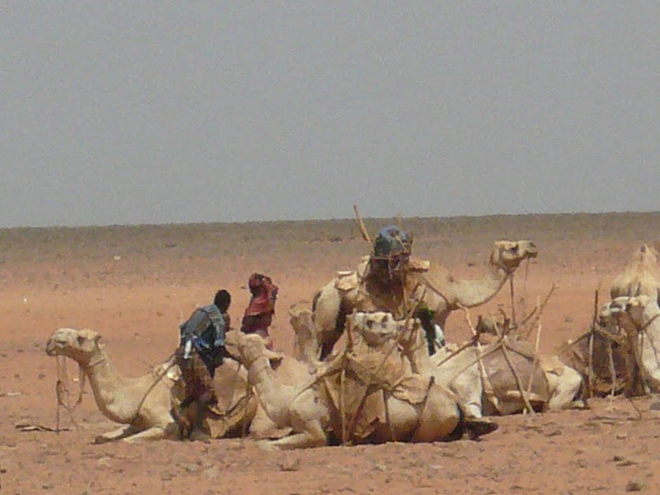
Thank you
Thank you for your time, interest and comments!

